Slide 1
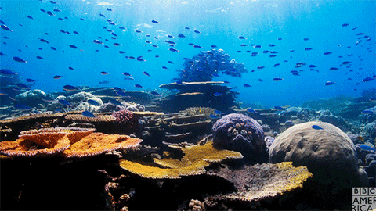
UNDERWATER EXPLORATION DRONE
RODNEY STAGGERS JR (ARIZONA STATE UNIVERSITY)
MENTORED BY PROF. JNANESHWAR DAS

Slide 2
ABSTRACT
This project is centered on crafting an autonomous underwater vehicle (AUV) to aid human divers that are proposed to take in-depth images of coral reefs

Slide 3
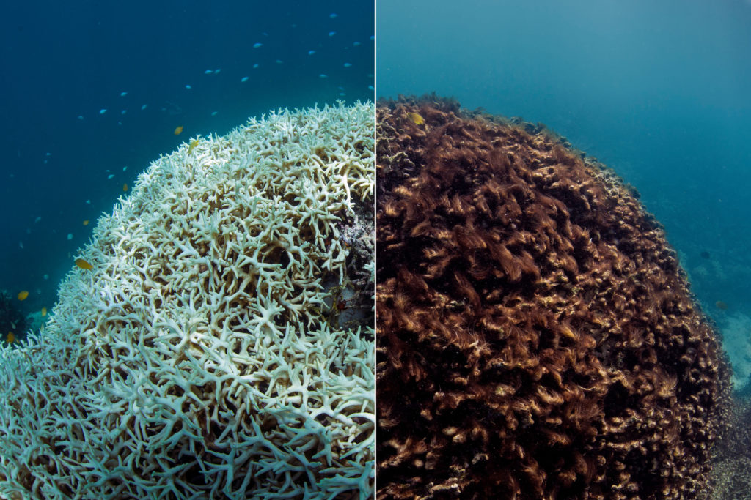
INTRODUCTION
Causes of Coral Reef Deaths
Increased UV exposure
Ocean level temperatures
Toxic runoff

Slide 4
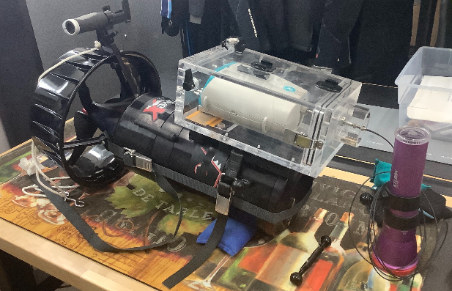
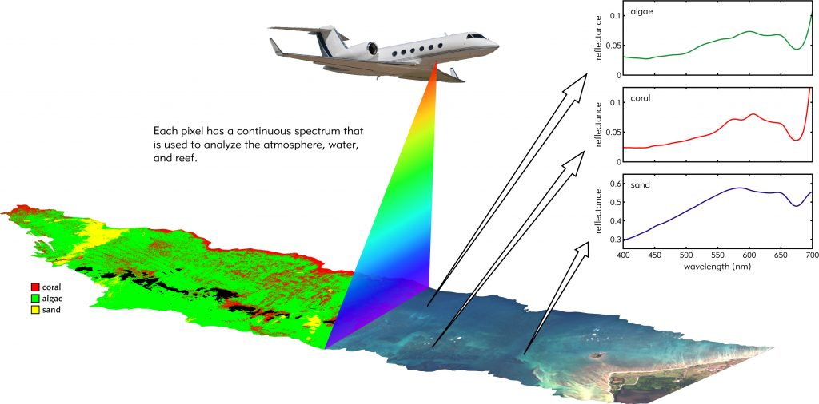
LIMITATIONS OF STRATEGY AND PROPOSED SOLUTION
Aerial spectrometer & DPVs
Limited number of experts
Costly Logistics
DPV’s cost is +$10,000
Room for casualties
Drone Requirements
Cost effective (<$10,000)
Go up to 30m below the surface
Stay within 1m of coral
Autonomously map and image
DPV (Diver Propulsion Vehicle)

Slide 5
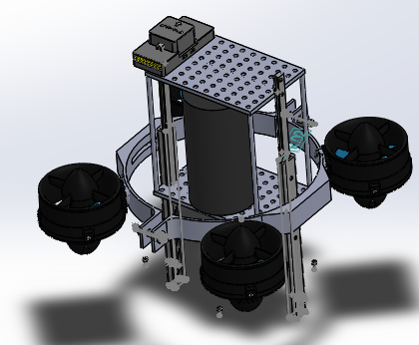
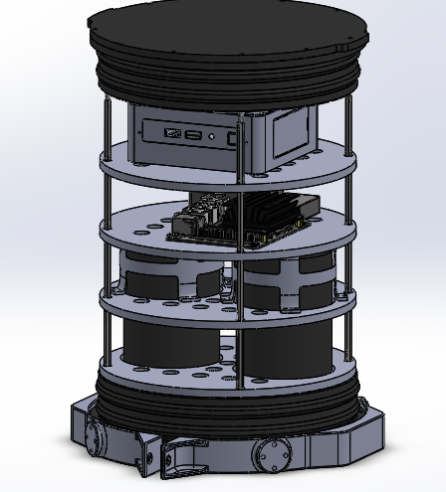
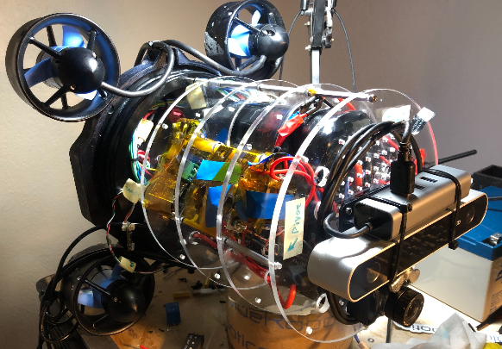
EVOLUTION OF THE FRAME
V1 V2 V3
Notes:
Internal frame had to be able to hold
Two Lithium-Ion Batteries
Pixhawk Flight Controller
Stereolab ZED2 and FLIR/Point Grey Chameleon 3 Cameras
Jetson TX2
Sufficient space for potential add-ons

Slide 6
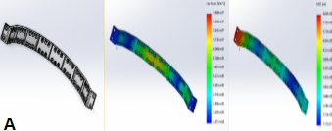
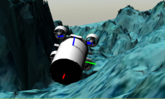
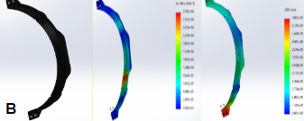
RESULTS
CAD Simulations for Hydrostatic pressure
At 30m, the max. pressure is 302.8kPa gage
(A) is the sensor mount and (B) is the motor mount

Slide 7
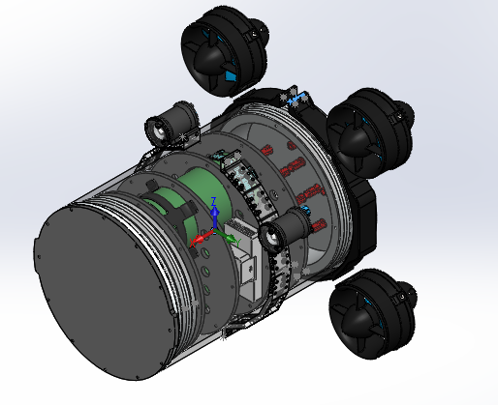
EQUATIONS OF MOTION
M: rigid body structure (mass and inertia tensors)
C(v): Coriolis effect and centripetal forces and moments
D(v): drag forces and moments (neglected for simplicity)
g(η): gravity, buoyancy, and moments about the center of gravity
τ: vector of input forces and moments (from thrusters and current)
Z
X
Y

Slide 8
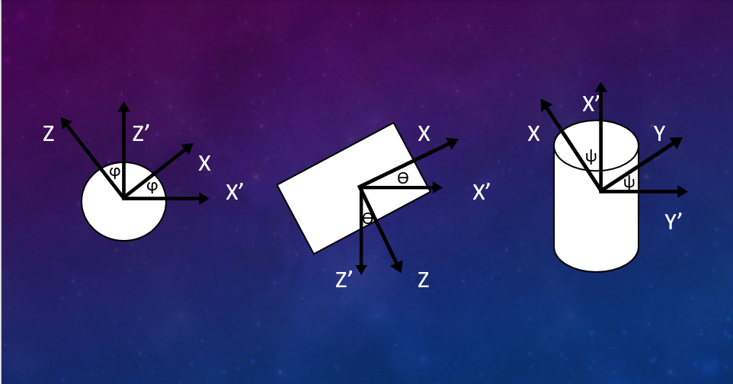
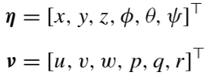
STATE OF MOTION
η is the vector of position and orientation
v is the vector of angular velocities (u, v, w) and angular accelerations (p, q, r)

Slide 9
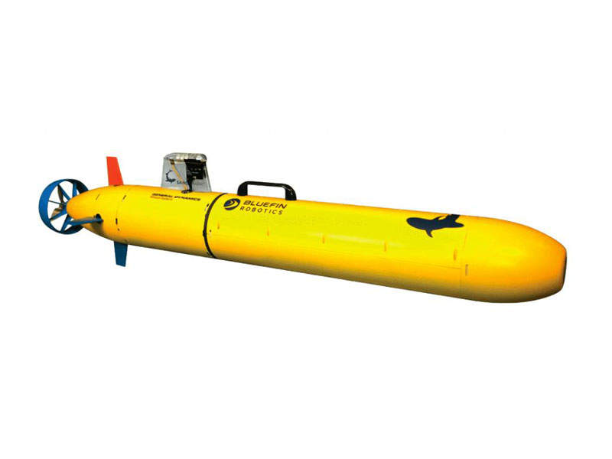
COMPARISON TO CURRENT MODELS
Unlike typical AUVs, it has multi-rotor thrusters
Able to retain memory and coordinate movement
Full range of motion (no sawtooth pattern)
Bluefin-21 (Typical AUVs)
Seabotix
Notes:
This same application can be applied to Space Exploration
Multi-rotor thrusters
No or little gravity as well as drag
Hovering or Drifting, turning in place, ROV have tether or inspection
UAV: turbines (one thruster/fin w/sawtooth)
Navy

Slide 10
DISCUSSION
Application for Space Exploration
Ability to deploy over an area and navigate
Similarities between drone and a rocket
Modified dynamics can be used to adapt to non-terrestrial exploration

Slide 11
CONCLUSIONS
Final Cost: $4000
Upcoming Plans:
Test the VIO when immersed underwater
Manufacture an updated drone

Slide 12
ACKNOWLEDGEMENTS
Thanks to the NASA Space Grant Consortium, the D.R.E.A.M.S. LAB, Prof. Jnaneshwar Das, Alex Goldman, Cole Brauer, and Harish Anand for their guidance and collaboration.

Slide 13
REFERENCES
https://www.google.com/url?sa=i&url=https%3A%2F%2Fgiphy.com%2Fexplore%2Fgreat-coral-reef&psig=AOvVaw0f_w9xH9qNe2H6aQ9bxm6_&ust=1585893093988000&source=images&cd=vfe&ved=0CA0QjhxqFwoTCIDFsqeGyegCFQAAAAAdAAAAABAD
https://www.google.com/url?sa=i&url=https%3A%2F%2Fwww.pbs.org%2Fnewshour%2Fscience%2Fhow-global-warming-is-permanently-reshaping-the-great-barrier-reef&psig=AOvVaw1S2ZRi0EtHN9lHs30gj_Sw&ust=1585858868385000&source=images&cd=vfe&ved=0CA0QjhxqFwoTCMCMy6SHyOgCFQAAAAAdAAAAABAD
Mantha, Maitreyi. “Back-To-Back Mass Bleaching Decimates Australia's Great Barrier Reef.” DOGOnews, DOGO Media, Inc., 03 Jun, 2017, www.dogonews.com/2017/6/3/back-to-back-mass-bleaching-decimates-australias-great-barrier-reef.
https://www.naval-technology.com/wp-content/uploads/sites/5/2017/09/LBV200-4-rov1.jpg
https://robots.ieee.org/robots/aqua/Photos/SD/aqua-photo1-full.jpg
https://www.naval-technology.com/projects/bluefin-sandshark-micro-autonomous-underwater-vehicle/
Fossen, Thor I., Handbook of Marine Craft Hydrodynamics and Motion Control, First Edition. 2011, John Wiley & Sons Ltd.

